Slide 1
Graduate Student Funding Fall 2023
Originally Developed by:
Jill Sharkey
Ali Muller
Jacob Kirksey
Kelly Hayton
Updated annually
Contact Boris Palencia for Financial Support
Contact Beverly Perkins for Research Grant Questions

Slide 2
Strategic Planning Goals 2020-2024
Goal 1: Recruit students, faculty, and staff to GGSE who support research, teaching and service critical to serving the diverse population of California.
Objective 1A: Offer stronger multi-year funding packages to graduate students; double graduate student “quarters funded annually.”
Goal 4: Increase GGSE collaborations within UCSB, the UC System, and the broader community that follow a model of shared expertise and promote equity-serving research and learning opportunities.
4C: Build the GGSE policies, structures, and supports needed so that each faculty member will be engaged in significant research collaborations and/or community collaborations.

Slide 3
Agenda
How Does Employment Work?
Research Grants and GSRs
Block Grants and TAships
Department Decision Making
Campus information, resources, and tips
Question and Answer

Slide 4
How Does Employment Work?

Slide 5
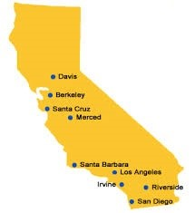
The University of California is our employer
100% is Full Time Equivalent (FTE) working for an employer. We all work for the University of California (UC).
You work for the UC when your employment is within the GGSE, across campus, partially for another UC, or a combo. All employment is collective.
FTE is based on a 40-hour work week
10 hours per week is 25% FTE (10/40)
What is 4 hours per week?

Slide 6
Except during the summer, graduate students cannot work more than 50% for UC unless they receive an exception* and obtain necessary approvals.
Up to 75% needs departmental exception
75-100% requires graduate division exception - rarely granted
International students may only ever work up to 50% (federal law)**
Thus, it is critical to communicate with supervisors when combining employment, e.g., tell them if you accept a TA.
*Teaching Associates and most international students may not work above 50%.
**Permanent Residents, Green-card holders, and DACA students are allowed to work up to 75% in the academic year with an approved employment request.
Notes:
All appointments or combined appointments are limited to 50% time (an average of 20 hours per week) during the academic terms. An exception may be granted by the home department for a graduate student to be compensated for a maximum of 75%; appointments above 75% require Graduate Division approval (see the exception process below). The 50% time restriction will apply without exception for Associates and international students, dependent upon their visa type or country of origin (consult the Office of International Students and Scholars for further information). All continuing students may work 100% time during the summer, provided they were registered and paid fees for the immediately preceding spring quarter.
Students can become a Teaching Associate after being a teaching assistant for 3 courses and having earned a master’s degree. Teaching Associates are the instructor of record.

Slide 7
Hiring Process
Every potential employee must complete the hiring process before they can work.
Hiring includes an intake at GGSE.
Next you complete the I-9 process with Business & Financial Services.
Full legal name
Proof of identity (e.g., license, passport)
Documentation of eligibility to work (e.g., birth certificate, SSN Card, Visa)
The process may include a background check and/or mandated reporting (CANRA) signatures.
For GSR/SA, you will know when process is complete when you receive an email notification.
A break in employment of any length triggers the need to redo the hiring process.

Slide 8
Graduate Student Researcher
“The student functions as an active collaborator and/or fundamental contributor to the intellectual content of the research”
Is considered “academic employment”
Academic employment triggers payment of partial or full tuition/fees starting at 25%
Is salaried and not hourly (no time card, you do not count your hours)
Student Assistant
Under supervision, perform duties ranging from unskilled to skilled…the work is unrelated to the educational objectives of the student’s degree program
Is not considered academic employment
Never contributes to tuition/fees
Is hourly, requires a time card, is not dependent on FTE
Neither position is paid on the academic calendar – you work year around
(e.g., during spring break, winter break).
Notes:
Discuss work breaks.

Slide 9
How much do I get paid?
12 months
9 months
=$66,666 for 12 months for comparison purposes
hourly
GSR/TA salaries are available at: ap.ucsb.edu/compensation.and.benefits/ucsb.salary.scales/
Student Assistant Guidelines are posted on the GGSE Resources Web Page
Notes:
The salaries above are at 100% FTE. To determine your salary multiple your FTE by the salary (e.g., 50% GSR1 = .5 x $3,457 monthly)
Teaching Associate positions are about $2,000 more than Teaching Assistant positions annually 100% FTE (see web link for details)

Slide 10
True Cost of a GSR: I make WHAT??!!!
Example:
The GSR is paid a salary plus student services fees, tuition, UCSB campus-based fees, and health insurance. This means that a 50% GSR at Step 2 (20 hours per week; $35K) plus tuition and fees ($20,900) will cost a grant approximately $55,900 over a full year of employment, the equivalent of a $112K annual salary for a full-time employee!
Notes:
GSR1 = first year of graduate school here
GSR2= second year
GSR3 = third year until you pass qualifying exams and become ABD
GSR4 = after passing qualifying examinations
The salaries above are at 100% FTE. To determine your salary multiple your FTE by the salary (e.g., 50% GSR1 = .5 x $3,457 monthly)
Teaching Associate positions are about $2,000 more than Teaching Assistant positions annually 100% FTE (see web link for details)

Slide 11
GSR Paid Personal Time Off
When the GSR’s appointment is at 25% or more for a minimum of one full month.
One day per month (at the %FTE) for every full month of appointed service at 25% or more.
The amount of paid PTO is communicated to the GSR directly on the written notice of appointment letter.
GSRs work year around and take the UCSB holidays. They do not get winter break/spring break etc. off.
GSRs can take unpaid time off.
Notes:
GSR1 = first year of graduate school here
GSR2= second year
GSR3 = third year until you pass qualifying exams and become ABD
GSR4 = after passing qualifying examinations
The salaries above are at 100% FTE. To determine your salary multiple your FTE by the salary (e.g., 50% GSR1 = .5 x $3,457 monthly)
Teaching Associate positions are about $2,000 more than Teaching Assistant positions annually 100% FTE (see web link for details)

Slide 12
GSR Time Cards
GSRs must complete a time card
#1 Verify that you worked (simple yes or no, not your hours)
#2 Record any time off taken during the work period

Slide 13
Mandatory Trainings
Examples:
Substance Abuse Policy (2-5 min)
UC Abusive Conduct in the Workforce
Cybersecurity Awareness
Ethics and Compliance
These are required by your employment and are PAID tasks.
Notes:
GSR1 = first year of graduate school here
GSR2= second year
GSR3 = third year until you pass qualifying exams and become ABD
GSR4 = after passing qualifying examinations
The salaries above are at 100% FTE. To determine your salary multiple your FTE by the salary (e.g., 50% GSR1 = .5 x $3,457 monthly)
Teaching Associate positions are about $2,000 more than Teaching Assistant positions annually 100% FTE (see web link for details)

Slide 14
Combining Employment
Graduate students cannot work >50% FTE without an exception.
Student assistantships count towards FTE but do not contribute to tuition/fees.
Academic appointments (e.g., TA, GSR) contribute to tuition/fees at 25% or more.
If a student has multiple academic appointments, each academic position contributes their proportion of tuition/fees based on salary amount. Examples:
25% GSR + 25% GSR: each contribute 50% of the tuition and fees.
25% GSR + 25% TA: GSR contributes their proportion of overall salary
Note about fellowships: If you have a fellowship that pays your tuition/fees it would not be financially beneficial to take an academic position at 25% or more; the academic position will have to pay your tuition/fees instead and the fellowship tuition and fees will be returned.
Notes:
Note: If you are combining employment and the total exceeds 50% the system will kick you out during the process and require you complete the exception paperwork and then start the UCPath process again.

Slide 15
Student Assistant Time Cards
Student assistant (non-exempt*) positions must complete a time card.
You will only be paid on time if you, first, and then your supervisor both approve the timecard on time.
Timecards are to be completed at the end of the pay period** and approved biweekly or monthly via Kronos.
Your Employment Request Approval/Processed email includes an important attachment that details pay periods and timecard requirements.
Pay cycles can change if student employment types change.
*Exempt positions require that employees customarily and regularly exercise independent judgment and discretion more than 50% of the time. These positions are exempt from minimum wage and overtime provisions. They are paid an established monthly or annual salary and are expected to fulfill the duties of their positions. Exempt employees may or may not be required to complete time cards. GSR and TA positions are exempt positions.
**Each employee is either on a biweekly or a monthly pay schedule. The decision for a particular employee to be biweekly or monthly is individual. Variables typically include whether the employee has a combination of academic (GSR or TA) and non-academic (Student Assistant) appointments.
Notes:
Note that if you or your supervisor fail to sign the timecard on time, the case goes to UCPath where it gets resolved in an unknown and often lengthy amount of time.
As a Teaching Assistant, you are expected to work no more than 220 hours for an appointment at 50% time during the academic quarter, including no more than 40 hours in any one week or 8 hours in any one day. It is your responsibility to notify your Faculty Supervisor if you should exceed the approved number of hours set forth for the academic quarter. The Hiring Department either may increase the appointment percentage or may modify your work assignments such that the number of hours worked will be consistent to the appointment percentage/hours normally set forth. Any changes to your appointment is to be communicated in writing between you and the Hiring Department.
Pay delays depend ON THE CAUSE, THE VOLUME. IF PAY PROBLEM (UNDERPAID/OVERPAID), SEND EMAIL TO UCPATH@EDUCATION.UCSB.EDU WITH DETAILS AND PAY STUB IF APPLICABLE. THIS WILL BE REVIEWED AND NECESSARY ACTION TAKEN

Slide 16
Time Cards
You ask, how can I facilitate my own time card process?
Add handy approval calendar to your Google calendar. *
Add event notifications for reminders
Log on to Kronos to approve the timecard.*
Once you sign, notify your supervisor.
Confirm they sign the timecard before the deadline.
I need help figuring out how to use Kronos!
Make an appointment with Tracey Velasquez
Submit an online ticket at https://timekeeping.ucsb.edu/ or call x5000
*at GGSE Resources: education.ucsb.edu/ggse-resources

Slide 17
Deadlines for Employment
Hiring procedures are complicated and can take a long time due to numerous required steps (e.g., assessment, processing, approval).
A significant amount of time is needed at the start of each quarter (Jan 1, April 1, July 1, Oct 1) due to the high volume of employment requests made at those times. Due dates are emailed and are often up to 2 months before the upcoming quarter.
All other employment requests must be made at least ten business days (two weeks) before the requested start date.
Delays can be caused by, for example:
Background checks
Mandated reporting certification
Obtaining official documentation (birth certificate, etc.)
Changing pay cycles (adding new type of employment, etc.)
Funding source not yet secured (new grants, no-cost extensions, etc.)
UC Path
CA Employment Law

Slide 18
Research Grants and getting a GSR
What are research grants?
Who gets a GSR?
How can you get a GSR?
Notes:
This is an opportunity for a brief discussion with the main point that faculty obtain research grants to support their research and train doctoral students in particular topic areas and methods. They typically fund only students they advise or who are in their topic area.
Students can provide input on what a GSR is like and how to network for a GSR if your advisor doesn’t provide that opportunity.

Slide 19
1. What is a Research Grant?
Grants to do research. They may be department or subject/methodology specific. This will be part of your graduate student training. Typically, will receive them from professors in your research area. It is possible to be hired by someone who is not your advisor, but it is not necessarily guaranteed and can be a risk for the PIs because you aren’t guaranteed to stick around as much as their own students are.
2. How can you get a GSR?
Ask professors, read emails, look on the Contracts & Grants website, Ask a professor to co-author a grant and write yourself in as a GSR if possible.
Note that it is really expensive to hire a graduate student so be aware that you are asking for a lot of money even if it doesn’t feel like that much to you. Note that not all research grants are able to pay tuition fees, etc.

Slide 20
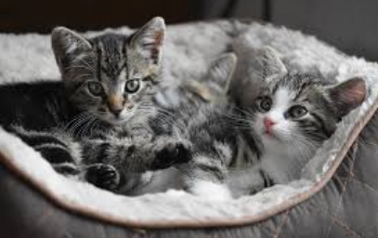
Block Grants and TAships
What are Block Grants?
What are TAships?
Who gets these funding sources?
How can you obtain these funds?
Notes:
This is an opportunity for a brief discussion about Block Grants and Taships broadly in ways that are not department specific.

Slide 21
Block Grants
Each department gets a block of money from Grad Div to provide to students that they then decide how to support grad students with.
Each department does it differently so communicate with your department chair.
Grad div has stated that they want it to be given in larger chunks and to tell students what they are going to get when they are admitted.

Slide 22
CCSP-Specific Information
CCSP historically covers all first year tuition/fees with fellowships and block grants.
CCSP historically provides one quarter block grant to cover tuition/fees annually after the first year.
CCSP has an application process for TA positions. The positions are allocated as fairly as possible considering fellowship requirements, availability, qualifications, etc.
CCSP has an application process for fellowships; the application will be released in February and due in March.

Slide 23
GradPost Funding Forecast
Funding Pages
Articles
Workshops
Budgeting and personal finance
Finding funding
Taxes
http://www.gradpost.ucsb.edu/money
Notes:
Ali: this webpage has tons of funding resources including workshops, grants, fellowships, and post graduate work options. You can get a regular email digest with announcements.
Note: Ryan Sims from Graduate Division stated that he is able to meet with anyone who is struggling financially and can help them with a plan and with accessing extensive resources for supporting students through any type of financial difficulty or crisis.
Ryan Sims, M.A. (he/him/his)
Academic Counselor &
Associate Director, Academic Services
805-893-2068 (Office)
Note from Kelly Hayton: Some funding sources need to go through the office of research and be submitted by an official from central campus so look into that and plan adequately to go through the appropriate process. Any grant or fellowship that is administered through UCSB or that requires UC authorized signature needs to go through the Office of Research. Complete a SPOOF (at least 30 days prior to due date) to get started: https://ucsbeducation.az1.qualtrics.com/jfe/form/SV_6yuCSfVFNkmZhI1

Slide 24
Central Campus Fellowship
Central Campus Fellowships at Recruitment
Due in January announced in February
Often provide tuition/fees/stipend in some years
Department provides 50% employment in alternate years
Resources obligated to students with fellowships
Fellowships help avail block grants funds
Notes:
Jill & Karen & Amy
This slide is to help provide context for fellowship support.

Slide 25
Central Campus Fellowship: Continuing
Allocated to your department each year Complete your Diss Proposal by March in order to be eligible
Notes:
Jill & Karen
http://www.graddiv.ucsb.edu/forms/Competitions2020
Complete your qualifying exams by March in order to be eligible for prestigious and very supportive dissertation fellowships!

Slide 26
Travel Grants: UCSB Campus
Academic Senate ABD Doctoral Student Travel Grants
Doctoral students who have been invited to present at a major conference/meeting
First-come, first-served, eligible to receive two total.
Deadline is at least 21 days in advance of travel
Divided by timing of conference
Pool One: July 1 and Dec 31
Pool Two: Jan 1 and June 30
Divided by division/school
$250 Virtual
$450 California
$900 U.S., Mexico, Canada, Puerto Rico
$1,500 International
https://senate.ucsb.edu/grants/doctoral-student-travel/
UCSB GSA Conference Travel Grant
Offsets costs of professional conferences when presenting original findings
$250 in reimbursement
Available 1x/academic year
45 are available each quarter, selected by lottery
https://gsa.ucsb.edu/funding/conference-travel-grant
Notes:
Jacob & Amy

Slide 27
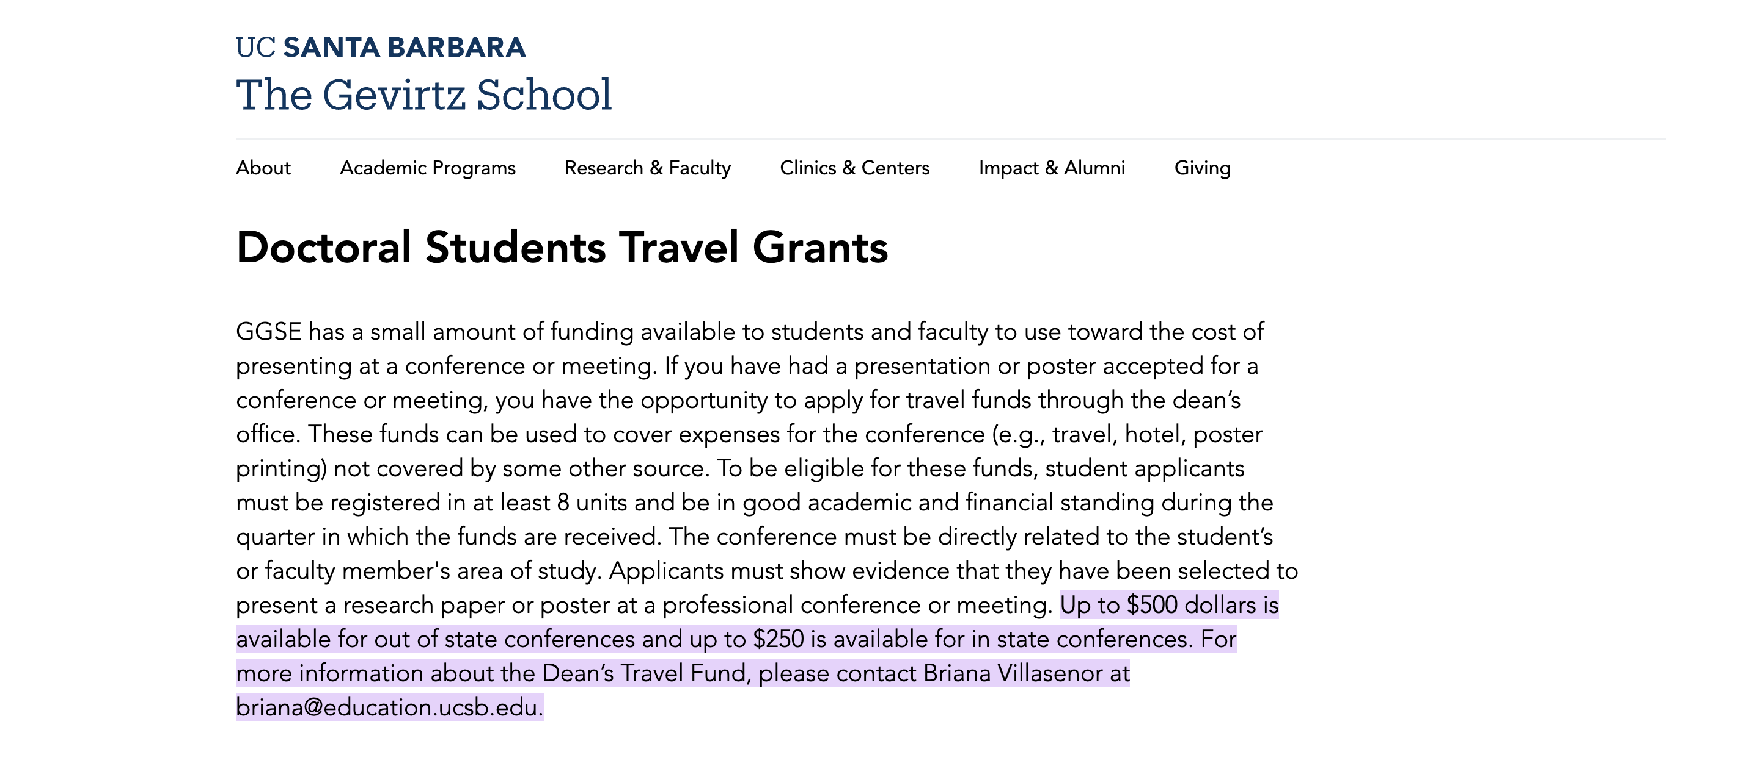
Travel Grants: GGSE Dean’s Travel Grant
Notes:
Jacob

Slide 28
Travel Grants: Your Department
Applications for Travel Grant funding must be made at least 28 days prior to travel
EDUC
Two calls for travel grants, one in Fall one in Winter.
Depending on the time of acceptance of conference.
Amounts parallel campus Academic travel grant.
Fixed amount each year, so depending on the amount to applicants, amounts can vary
CCSP
One call for travel grants, in Winter
Travel dates are 9/1/19 through 8/31
Aim to match academic senate travel amounts, dependent on available funds and number of applications
Note: If you obtain multiple travel grants for the same trip, you need to have sufficient funds to claim them all.
Notes:
Jacob, Brenda & Tania

Slide 29
Tuition Coverage: TA outside GGSE
How do I find a TA position outside the department? (see notes)
What are the benefits?
What are the drawbacks?
Review: What are the salary/benefits for TAs?
Taships never cover full fees, there is a $228 gap between full and partial tuition for TAs at any FTE.
Taships do not cover international fees (NRST)
Note: The same employment rules apply so coordinate with other supervisors to manage % and tuition/fees coverage
https://ap.ucsb.edu/resources.for.prospective.employees/graduate.student.academic.appointments/ase.open.positions/ase.open.positions.2021-22.pdf
Notes:
Ali
Note: Departments must cover the costs of tuition and fees out of their departmental budget.
Finding a position outside the department: information
- To obtain a TA position outside the department you can identify departments with available TA slots and contact them directly through email and/or an in person visit to apply.
According to Article 22 of the contract covering Academic Student Employment for UC graduate students, the University is required to begin posting all available ASE positions for the next year on the campus website. Although allocations for academic year 2020-21 are not yet available, please send us your estimates, and we will update the listing later as necessary. If you anticipate that all your positions will go to current or incoming ASEs in your department, you can let us know that you have "no positions currently available," and we will post that on the website. In particular, please verify your departmental contact information, even if you have no open positions.
Please send the following information for your department:
For SUMMER 2020
Type of position: Teaching Assistant, Associate, Reader, Remedial Tutor
Anticipated number of positions for each type
Name/phone number/email address of the contact person for the hiring department
For ACADEMIC YEAR 2020-21
Type of position: Teaching Assistant, Associate, Reader, Remedial Tutor
Anticipated number of positions for each type
Name/phone number/email address of the contact person for the hiring department
The listings will be posted on the Office of Academic Personnel’s website at:
https://ap.ucsb.edu/resources.for.prospective.employees/graduate.student.academic.appointments/

Slide 30
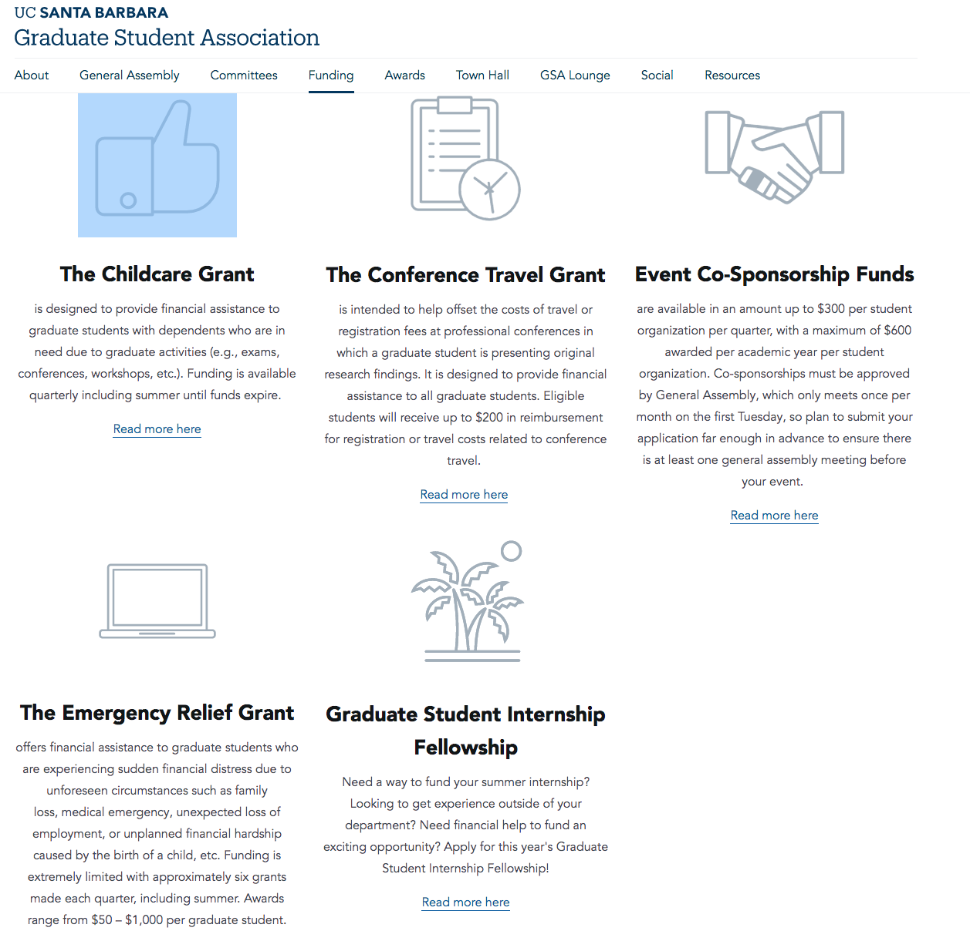
Graduate Student Association https://gsa.ucsb.edu/funding
Notes:
Jill/Ryan

Slide 31
Emergency Funding
Financial Crisis Response Team (financialcrisis@sa.ucsb.edu)
GSA Emergency Relief ($100-1000)
Student Medical Emergency Relief Fund (SMERF)
Childcare Grants (https://gsa.ucsb.edu/childcare-grant)
Food Resources (e.g., Associated Students Food Bank; http://food.ucsb.edu/home2)
Notes:
Ryan Sims from Graduate Division Presenting
The UCSB Financial Crisis Response Team exists to assist students who are facing a financial crisis or urgent financial need. This effort aims to assist undergraduate and graduate students who are facing significant financial difficulties that jeopardize their path to graduation. The team works closely to evaluate, respond, and support students in crisis in a streamlined and timely manner.
The GSA Emergency Relief Grant was approved by the UCSB graduate student body in 2011 and is designed to help graduate students who are experiencing sudden financial distress due to unforeseen circumstances. Examples of this type of hardship may include, but are not limited to, the loss of an immediate family member, medical emergency, or an unexpected loss of employment. The amount of an award ranges between $100 and $1000 depending upon individual circumstances. The amount to be awarded is decided by the GSA Emergency Grant Advisory Board. The eight member Advisory Board consists of campus administrators, staff, and members of the GSA executive council.
The Jack Canfield Student Medical Emergency Relief Fund (SMERF) provides grants to students with expenses related to medical, dental, psychological, and optical emergencies. For the purpose of this fund, a medical emergency is a condition, injury, or illness that poses a risk to a person’s life, long-term health, or well-being and requires timely intervention.
** Prescription or medical care cost related to on-going, non emergency conditions are NOT Covered.
For all Dental requests we need the recommendation from student health dental to provide SMERF assistance. If this is a dental request/emergency please contact Student Health Dental @ http://studenthealth.sa.ucsb.edu/medical-services/dental-care
All requests are evaluated on a case-by-case basis.
Childcare Grants
Approved graduate students with single-child households will receive an award of $300; graduate students with more than one child will receive an award of $150 per additional child ($300 for a single-child house, $450 for a 2-child house, etc.). Grants are limited to one award per graduate student per quarter, with a maximum of five awards allowed during a student’s academic tenure at UCSB.

Slide 32
Writing Workshops and Assistance
Writers Room
http://www.gradpost.ucsb.edu/writing (watch the video by Robby Nadler)
http://www.gradpost.ucsb.edu/writers-room
http://www.gradpost.ucsb.edu/writing

Slide 33
For future questions ask: Your faculty advisor Your graduate advisor Your department or fellowship chair Departmental staff Associate Deans We are here to help!
Thank you for your participation!

Slide 34
Q&A
Slide 1- Hiring at UCSB
What is the difference between a TA and a Teaching Associate?
TA helps with sections, Teaching Associate is the same as an instructor of record
Does the % restrictions apply to summer?
No, if you’re in good standing you can work up to 100%
Slide 3- GSR vs SA
How does percent time translate to SA?
You can’t work over 100% ever,
In an academic position (GSR or TA) 25%=partial fee remission, 35%+=full pay tuition
As a Student Assistant there is no fee remissions

Slide 35
Q&A
Slide 4- How Much You Make
These are all FTE so multiply by however much percentage that you are at
Slide 6- Time Cards
Student Assistants are flexible (i.e., If I work more hours in one week I can record it and then the following week I don’t work as much)?
Yes, just communicate your hours that are needed to complete the work to ensure that the PI has enough money
SA’s aren’t required to hit the percentage that they are hired at, they can work less. Just communicate that with your supervisor.

Slide 36
Q&A
Slide 8- Deadlines for Employment
How do you find out why your employment is delayed?
You can ask your supervisor and hopefully they know, or they can ask their analyst.
Can we ask the analyst directly?
Depending on the reason for the hold up there is a difference in who to approach. Typically you should approach your supervisor first.
Note that the employment request is just that, a request. Don’t start working until you get a confirmation email confirming that you are cleared to start working and getting paid.
If the faculty member has submitted the paperwork, and then they find out, for example, a background check is needed, who communicates that?
The student would be directly contacted in order to take care of that
Worst case, reach out to your supervisor to confirm a week before you are supposed to start working to see where the hiring process is at

Slide 37
ED-Specific Information
How does ED allocate block grants?
Historically: there is a block of money. Some of it is allocated for recruitment and some of it is dedicated to continuing money
Continuing money: application is in the spring
Don’t have to have gotten a block grant before to qualify
There’s also a dissertation block grant but once you receive it, you cannot receive another university support again
Communicate with your advisor to make sure they are advocating for you to the best of their ability
There is a committee who reads the applications and then makes decisions

Slide 38
How to get a TAship in ED?
Department Chair sends out a TA application goes out during the summer
Some of the classes have to be a specific person because of the content level that is being taught
Tell Department Chair if you want to TA so you’re on the list for consideration.
Reach out to other professors you’re interested in TAing for to get on their mind
There are some fellowships that requires the department to hire students with those fellowships
Brenda also sends out an email to remind everyone

